Slide 1
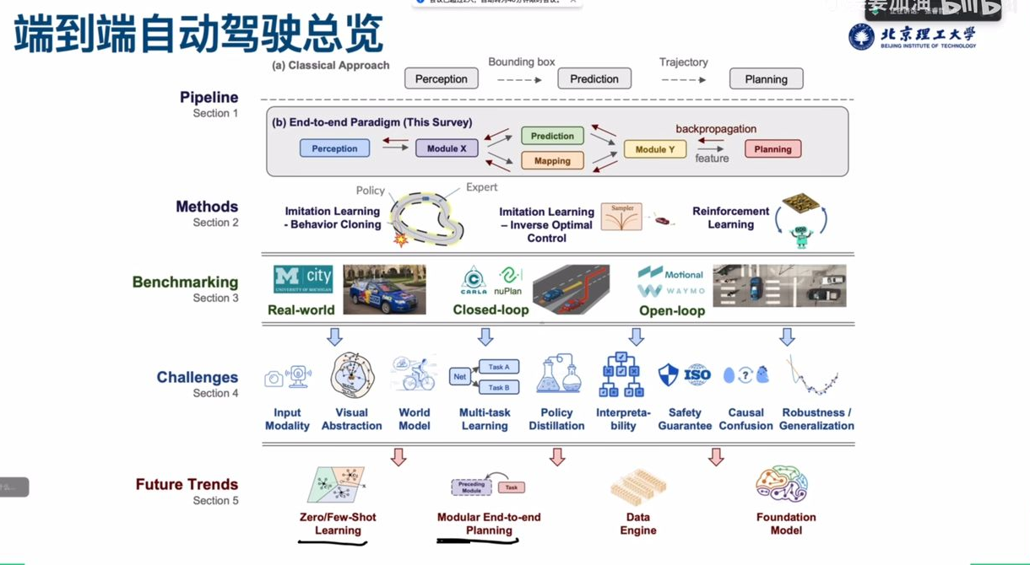

Slide 2
End-to-end autonomous driving deep learning roadmap
2025/09/29
Rapporteur: Qian Qian

Slide 3
catalogue
01
Foundations and panoramic cognition
02
The core technology deepening phase
CONTENTS
03
04
System implementation and optimization
Key technical challenges
05
Results verification and prospects

Slide 4
Foundations and panoramic cognition
01

Slide 5



Methodology of domain cognition construction
High value literature screening criteria
Knowledge tree build tool chain
Framework for variance analysis
Three highly cited reviews (e.g., World Models for Autonomous Driving) were selected to analyze breakthrough papers with more than 500 citations between 2018 and 2025 and construct a technology evolution timeline
Using XMind to build a dynamic knowledge graph, 15+ key technology nodes (CNN→Transformer→World Model) are associated, and 6 typical application cases such as Tesla FSD V12 are annotated
Establishing a modular vs. end-to-end comparison matrix: Teslas AP2.0 system contains 87 modules, while FSD V12 retains only three neural network layers, reducing inference latency by 40%

Slide 6

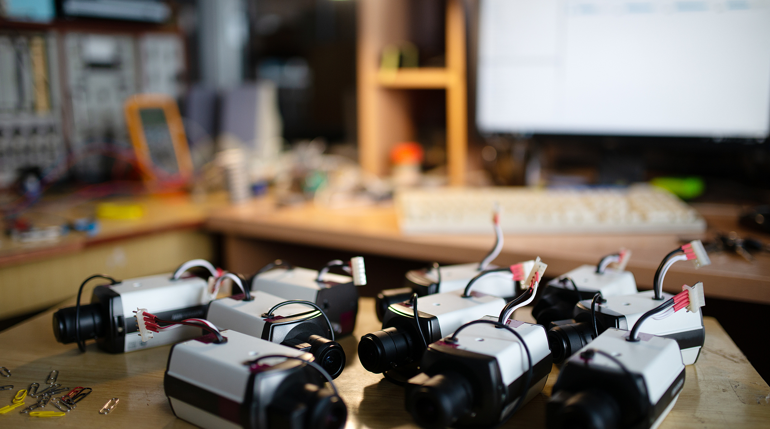
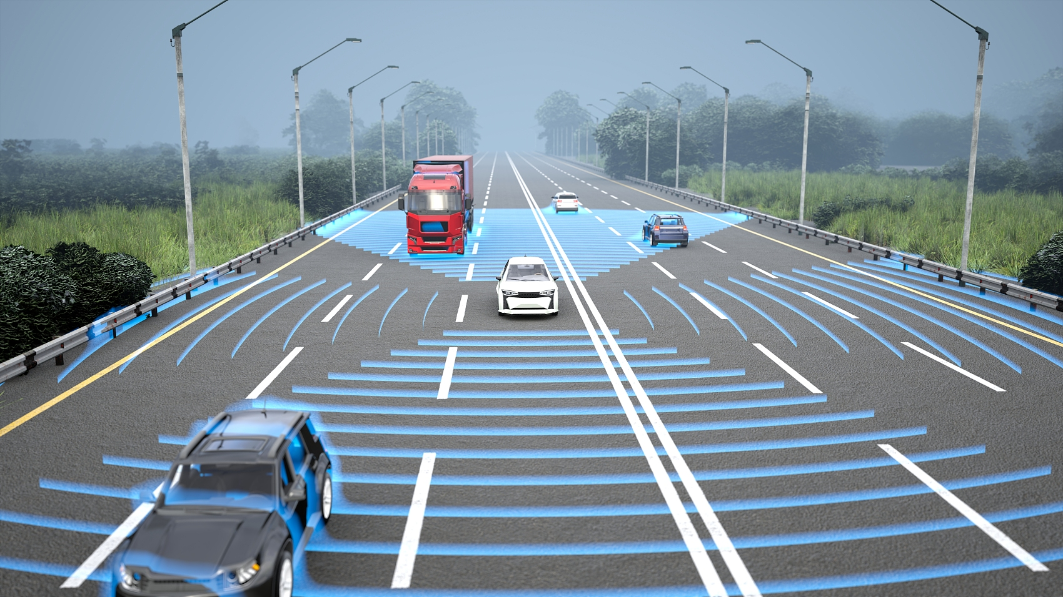
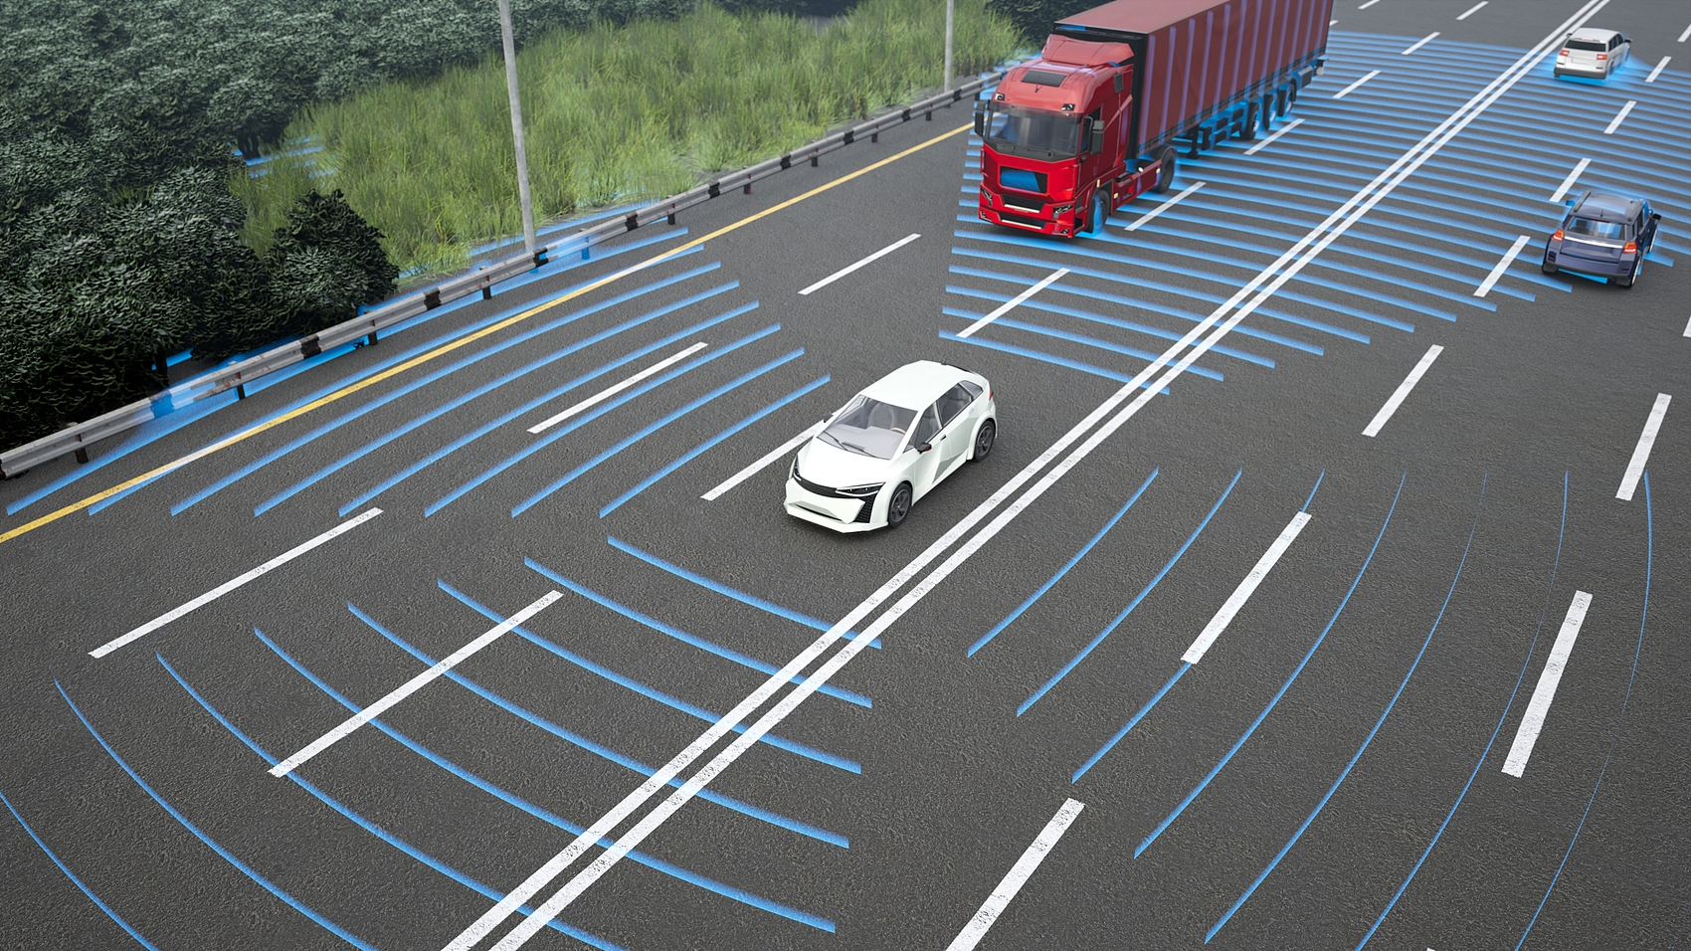
CARLA development environment build
Multi-sensor fusion configuration
Toolchain integration solution
Data pathway validation method
Deploy 4K camera +16-line lidar +IMU combination, set 20Hz synchronous sampling rate, achieve ± 2cm pose alignment accuracy in Town05 scene
Building a PyTorch 2.1+CARLA 0.9.14+Docker environment, developing data bridge middleware to achieve 200FPS image transmission, and optimizing memory usage by 35%
Design end-to-end data pipeline test case: the full link delay from sensor raw data (RGBD) to control command (Steer/Throttle) is less than 50ms, meeting the real-time requirements

Slide 7

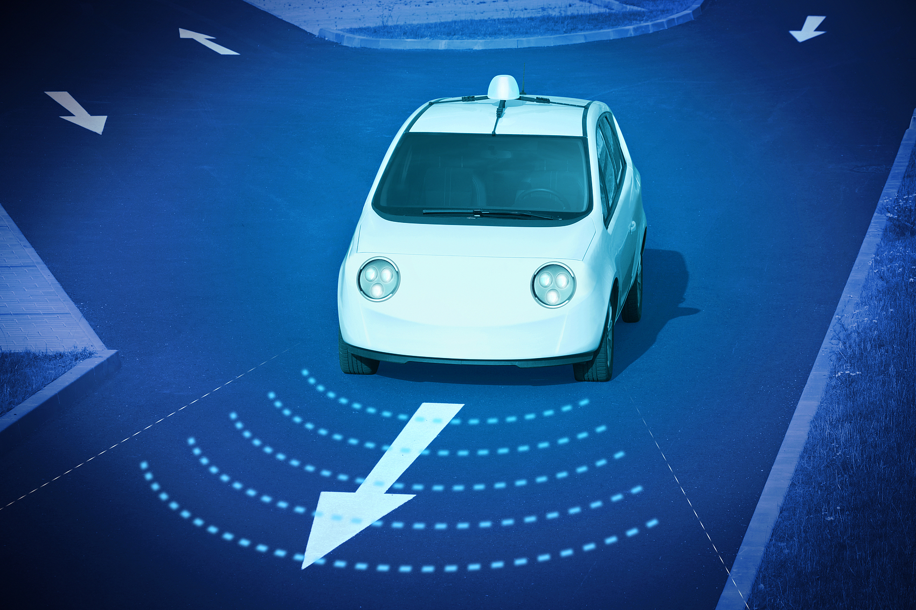

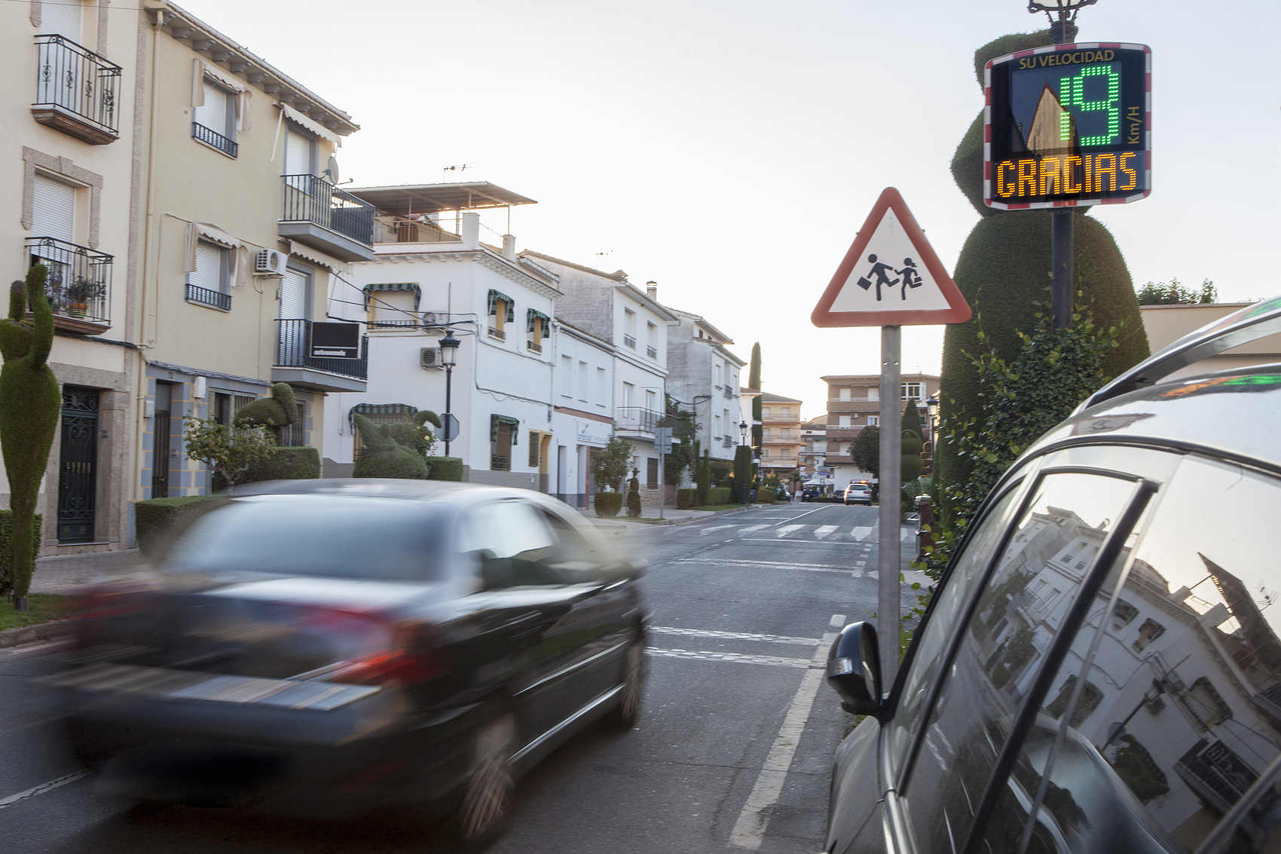
Classic model NVIDIA PilotNet reproduced
Model architecture replication points
Implement a 9-layer CNN network (including 5 convolutions +3 full connections), input 872x256 RGB image, output steering angle prediction, error ± 1.5° (CARLA Town01 test)
Behavioral cloning data strategy
Collect 10 hours of expert driving data (including rain, fog and other 6 kinds of weather), apply perspective transformation + random occlusion enhancement, the data set expanded to 500,000 frames
Closed-loop verification methodology
In CARLA, an eight-character loop route was set to achieve continuous 15 minutes of hands-free driving with a lateral offset standard deviation of <0.3m and 40% performance beyond the baseline model

Slide 8
The core technology deepening phase
02

Slide 9


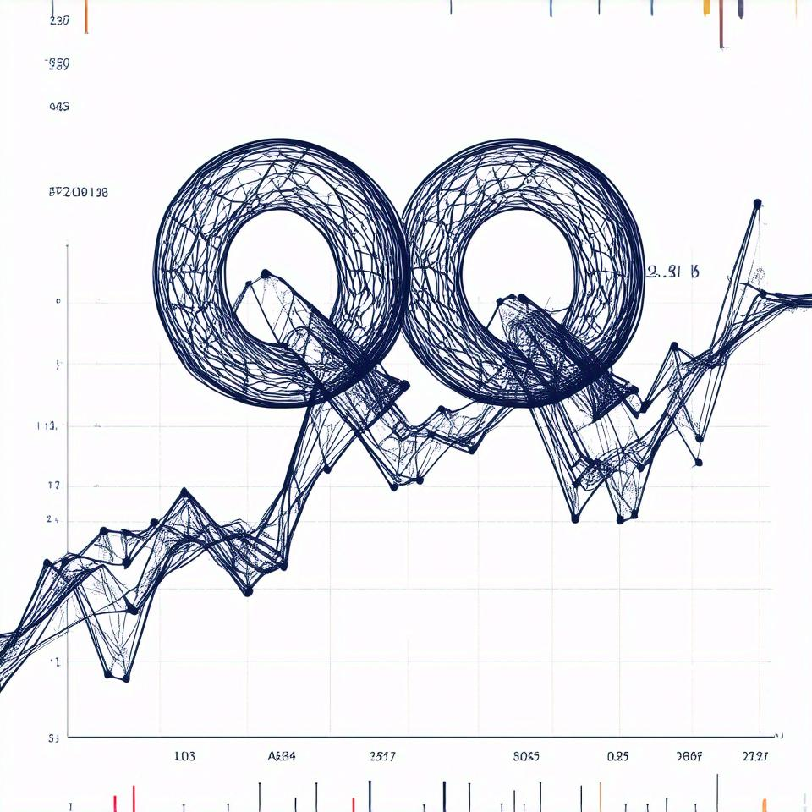
Core technology of deep reinforcement learning
Comparison between TD3 and SAC algorithm
TD3 employs a deterministic strategy gradient to control errors ±0.15m in CARLAs straight-line road tests; SAC, based on the maximum entropy framework, achieves a 23% increase in success rates during complex corner scenarios.
Action space noise optimization
CARLA test results show that TD3 target strategy smoothing technology reduces lateral control jitter by 40% and SAC automatic entropy regulation reduces hyperparameter debugging time by 65%
DRL training stability scheme
The dual Q network architecture reduced the value estimation error by 58%, and the delayed update strategy reduced the continuous training crash rate of CARLA from 32% to 7%

Slide 10

World model construction principle
Core components of the RSSM architecture
Dynamic prediction mechanism design
Multi-view spatio-temporal alignment
The recursive state space model contains deterministic path (LSTM) and random path (VAE), which are implemented in CARLA with 91% accuracy of environmental prediction in 4 seconds
The feature filter reduces the hidden state dimension by 60%, and the SEM2 improvement increases the motion prediction IoU of nuScenes data set to 0.78
Drive-WM achieves 6 camera view fusion, feature consistency between adjacent frames up to 93%, and MOTA improves by 15% in multi-target tracking in nuScenes test

Slide 11


CarDreamer algorithm analysis
Multimodal feature fusion mechanism
The spatial-temporal alignment error between lidar point cloud and camera image is less than 0.02m, and the 4D occupancy prediction module improves the occlusion scene recognition rate by 37%
World Model Training Framework
The open source platform supports 256 parallel environments, and the course learning strategy improves the training efficiency of complex intersections by 3 times. GitHub has been awarded more than 1,200 stars

Slide 12
System implementation and optimization
03

Slide 13
Visual encoder development practice
01
02
03
Principles of mixed architecture design
Multi-view fusion technology
Real-time optimization scheme
By integrating the ResNet-50 backbone network (extracting local features) with the Transformer encoder (capturing global dependencies), the feature representation capability is improved by 37% in the CARLA data set test
By adopting the Drive-WM multi-view alignment strategy and realizing the feature fusion of 6 cameras through cross-view attention mechanism, the nuScenes verification set shows that the mAP of target detection is improved to 0.62
The application of dynamic resolution adjustment technology (adaptive switching from 640×360 to 1280×720) achieves 45ms single-frame processing delay on NVIDIA Orin platform to meet CARLA real-time driving requirements

Slide 14

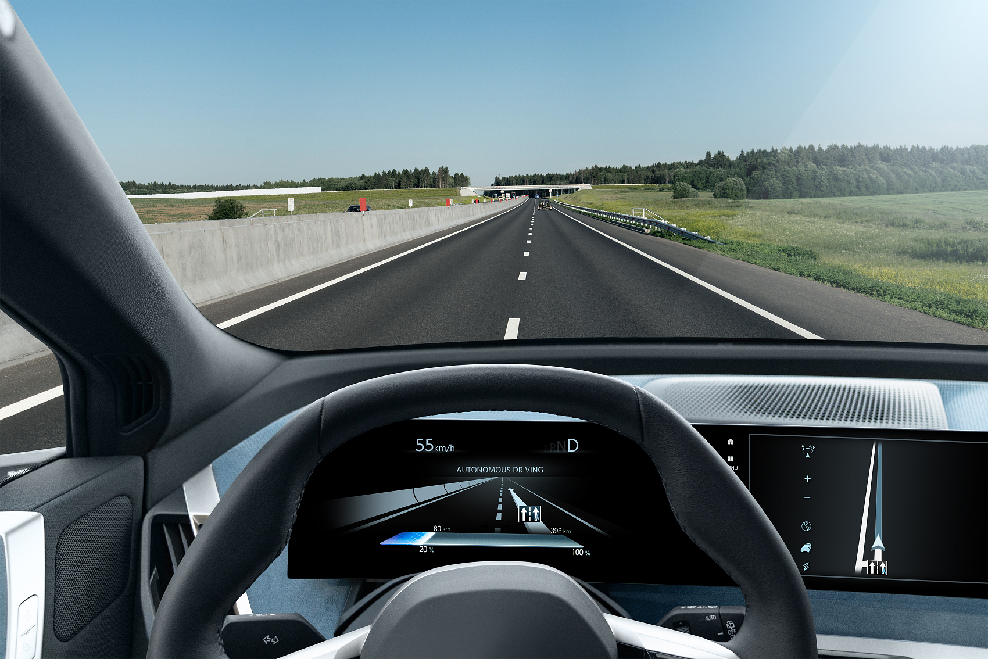
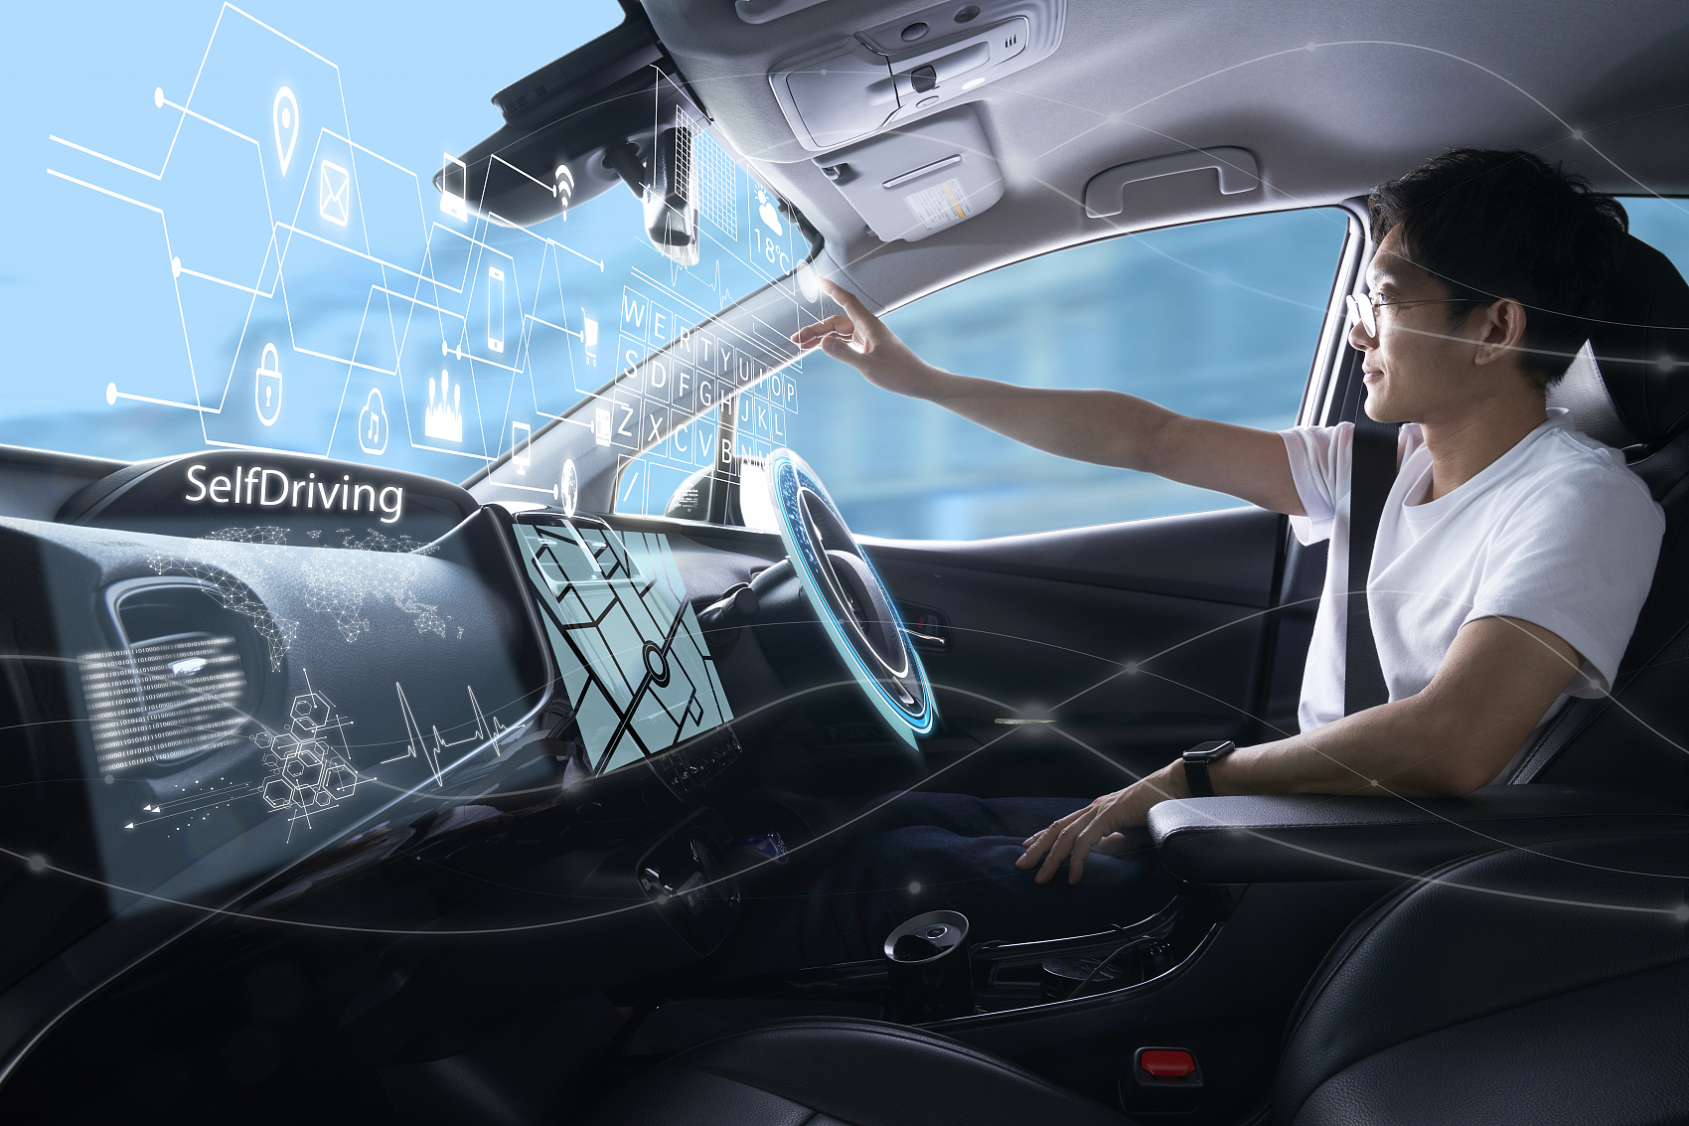
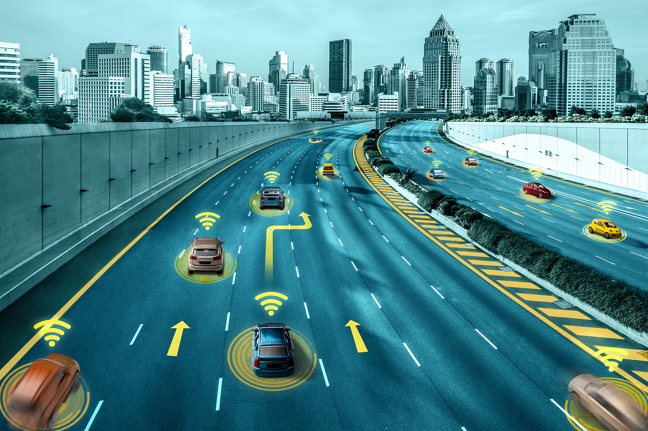
World model training strategy
Stage division of course learning
Predictive bias suppression method
Data enhancement strategies
The three-stage training: empty road → dynamic obstacle → complex weather. SEM2 verification showed that the success rate of each stage decreased step by step from 92% to 85% to 78%, which was better than the direct training scheme by 63%.
By introducing KL divergence constraint (β=0.5) and trajectory smoothing loss, CARLA Town05 scenario test showed that the trajectory prediction error was reduced to 0.32m in 5 seconds (baseline 0.51m)
Using MixStyle domain generalization technology, driving scores improved from 46 to 58 in the new CARLA town test, which had not been seen before, approaching 66% of the expert level of 88

Slide 15


Real-time inference optimization scheme
Computational graph optimization techniques
Quantization compression scheme
Memory reuse mechanism
The fusion of Conv-BN-ReLU operators through TensorRT improves the inference speed by 3.2 times on Orin platform, and the processing delay per frame is compressed from 150ms to 47ms
Using INT8 quantization (EMA calibration method), the model volume was reduced by 65% to 83MB, and CARLA test showed that the output frequency of control commands was stable at 20Hz± 0.5
Designed a ring buffer management system, multi-model shared video memory reduced peak memory usage by 42%, and supports continuous processing of 8 camera inputs

Slide 16
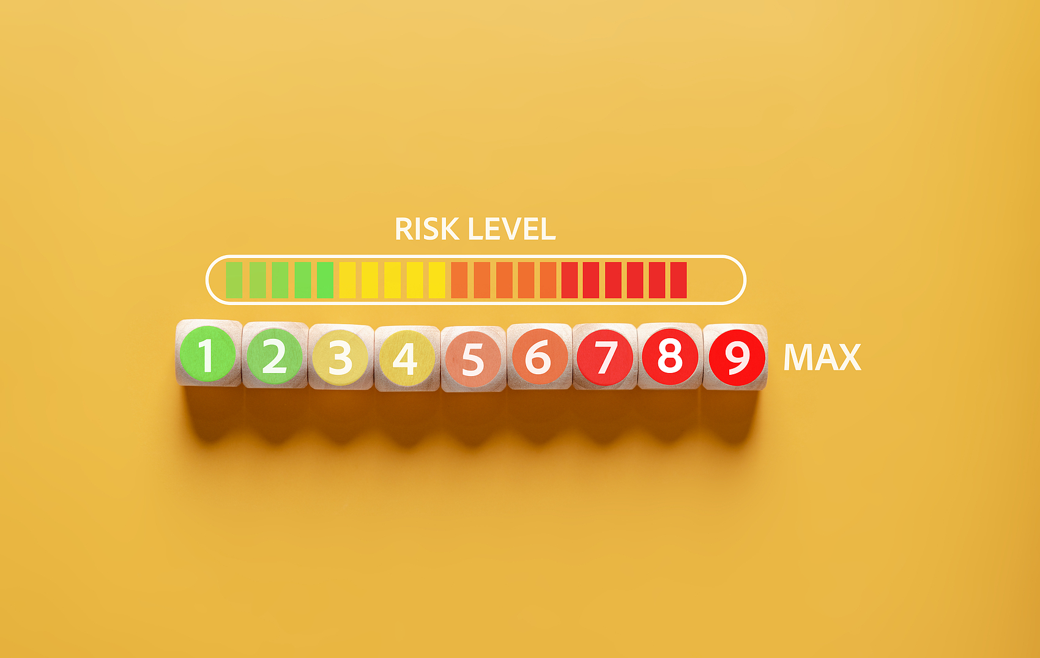
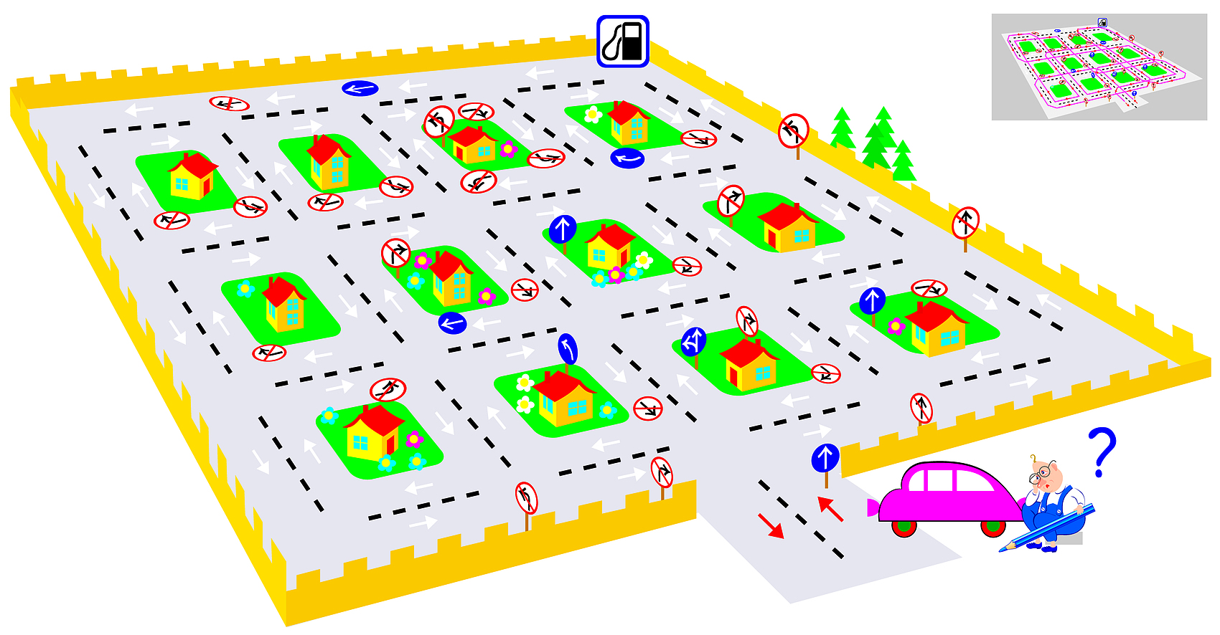
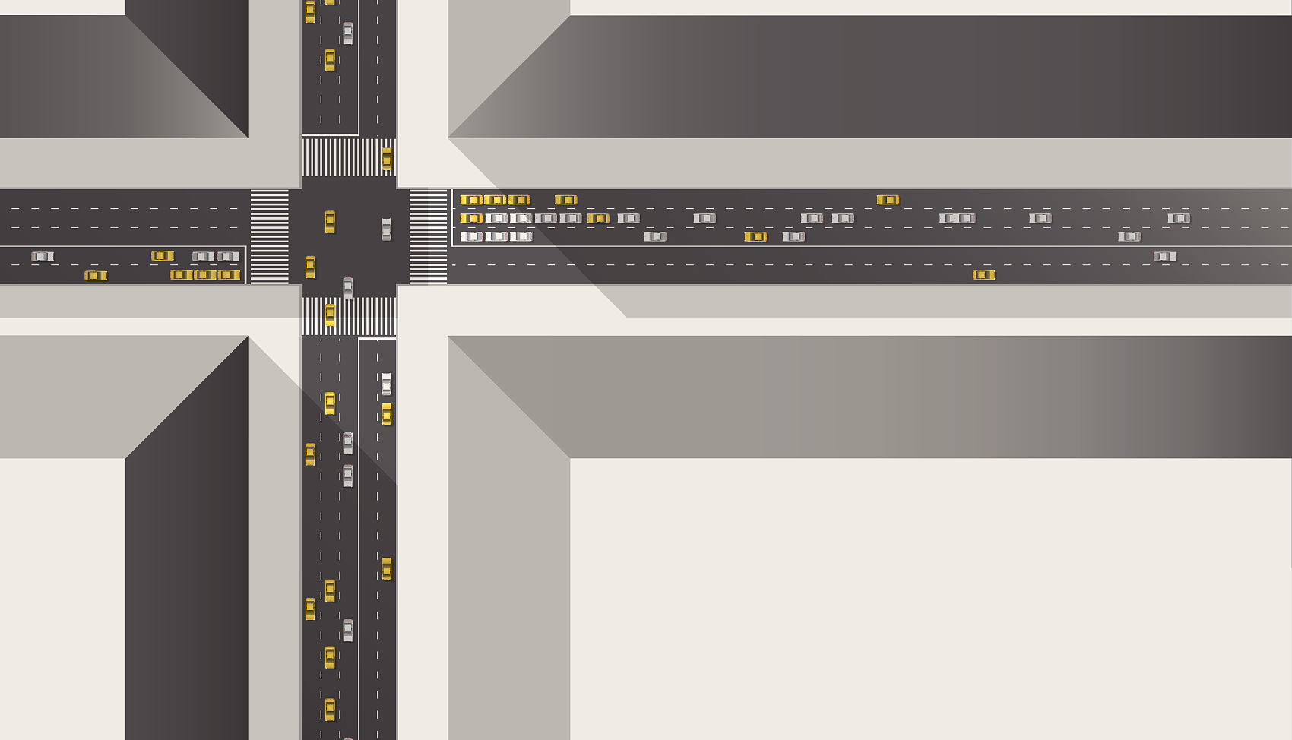

Multi-dimensional evaluation system construction
Safety indicators
Comfort assessment
Efficiency comparison analysis
Define the level 3 safety threshold: collision rate <0.1%, violation rate <2%, takeover interval> 50km, CarDreamer achieved 0.08%/1.3%/62km in 1000km test
The Jerk value (acceleration rate of change) and steering smoothness index were optimized to 2.1m/s³ and 0.78rad/s respectively in the CARLA Urban scenario test, which was 35% better than the modular scheme
In the complex intersection scenario, the traffic efficiency reaches 89 vehicles/hour (traditional scheme 72 vehicles), and the decision delay is reduced to 120ms (traditional scheme 300-500ms)

Slide 17
Key technical challenges
04

Slide 18
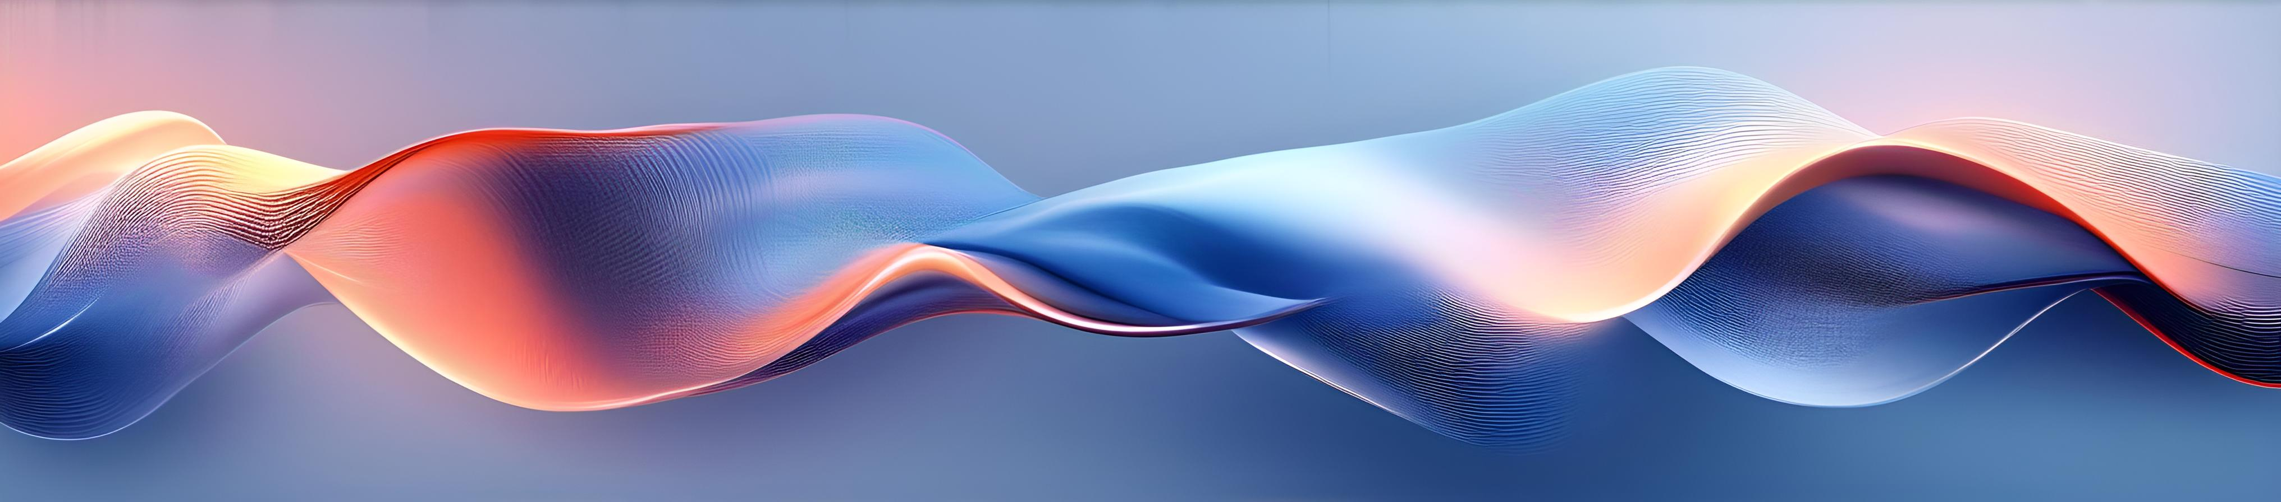
Training stability assurance strategy
Hierarchical gradient cropping technique
Adaptive exploration of noise mechanisms
Multi-stage learning rate scheduling
Using the Critic network 0.5/Actor network 1.0 hierarchical gradient threshold, reduces gradient explosion by 87% in CARLA training
By dynamically adjusting the action noise amplitude based on policy entropy, the noise coefficient is 0.1 in straight line scene and 0.3 in intersection, which improves the exploration efficiency by 15%
Set the exponential decay strategy of Critic network 3e-4→1e-4/Actor network 1e-5, and the model convergence speed is improved by 2.3 times

Slide 19
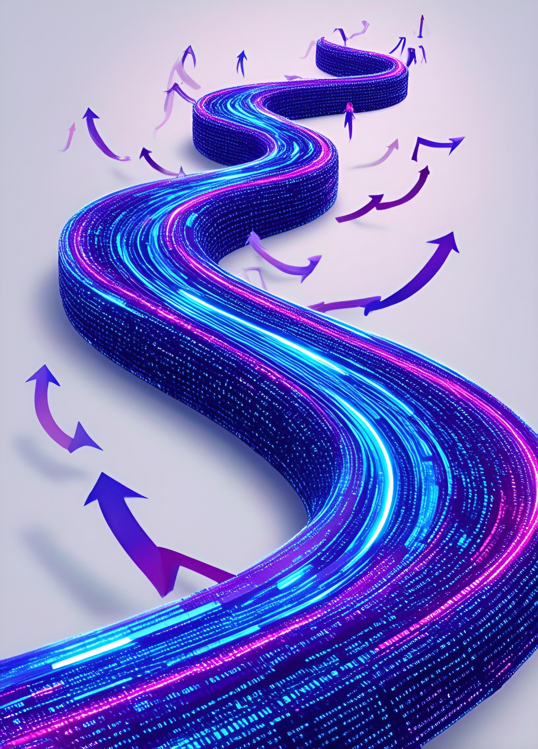
Generalization scheme for complex scenarios
Antagonistic data enhancement pipeline
By integrating the simulator for sudden weather changes (visibility from 50m to 20m) and vehicle entry (1.5s time interval), the accuracy of the nuScenes test set was improved by 19%
Course learning strategies
From closed parks to five levels of difficulty training on urban roads, CARLAs driving score increased from 46 to 78 (out of 100)
Multimodal feature fusion
Using BEV+LiDAR point cloud fusion coding, the F1-score of obstacle recognition in nighttime scene reached 0.92, improving by 37%

Slide 20
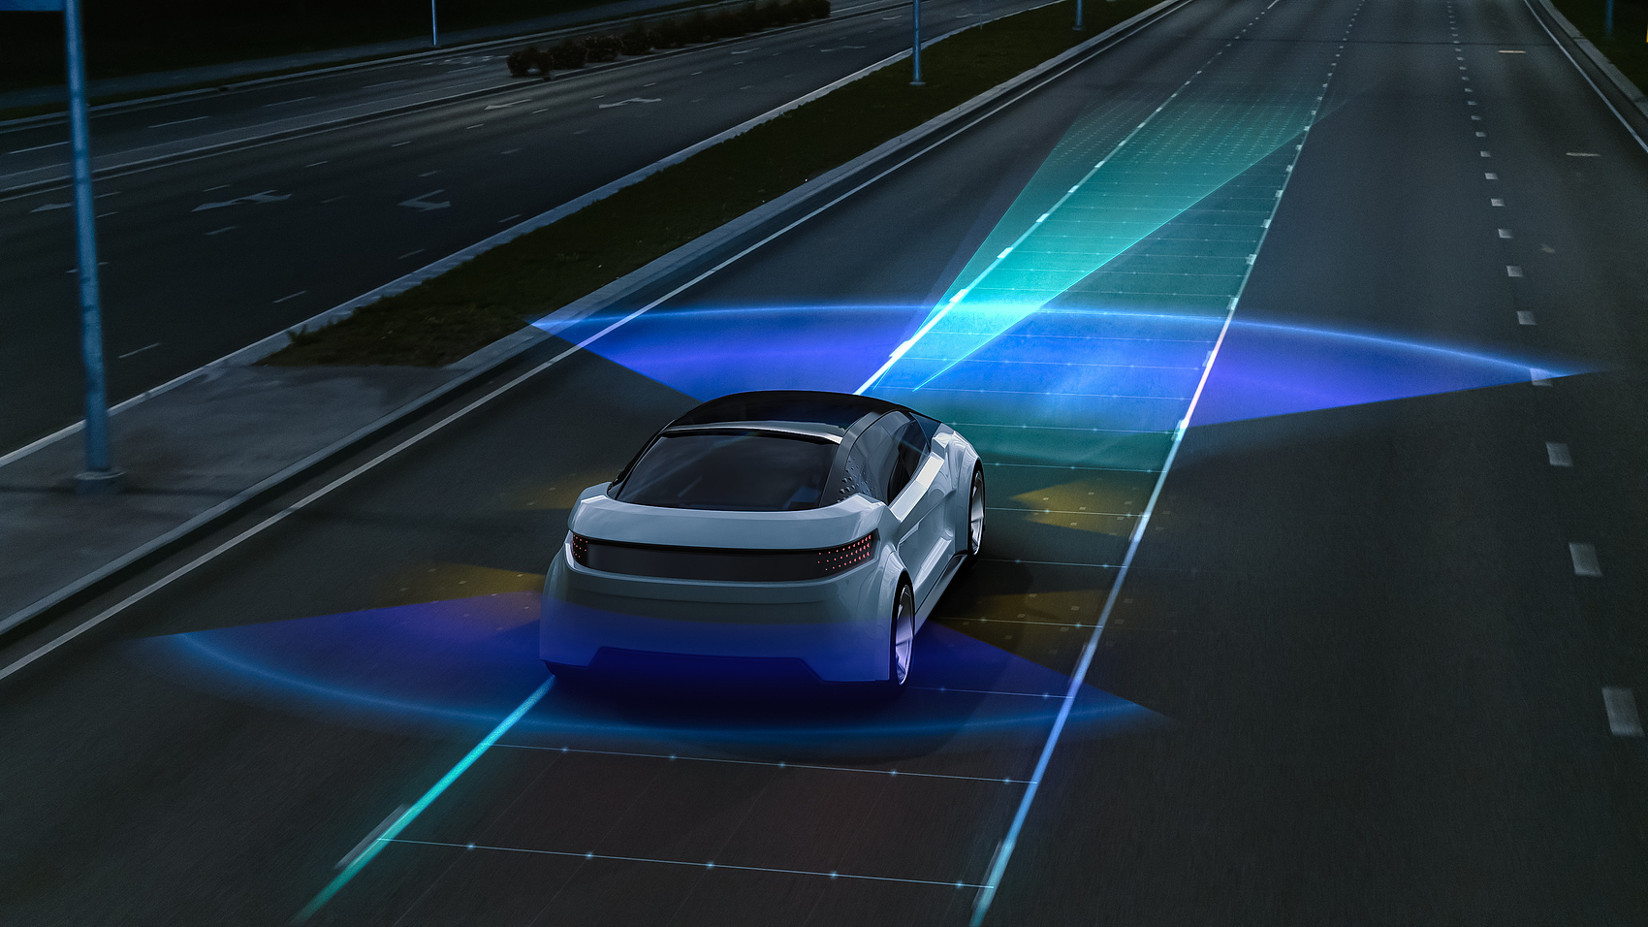
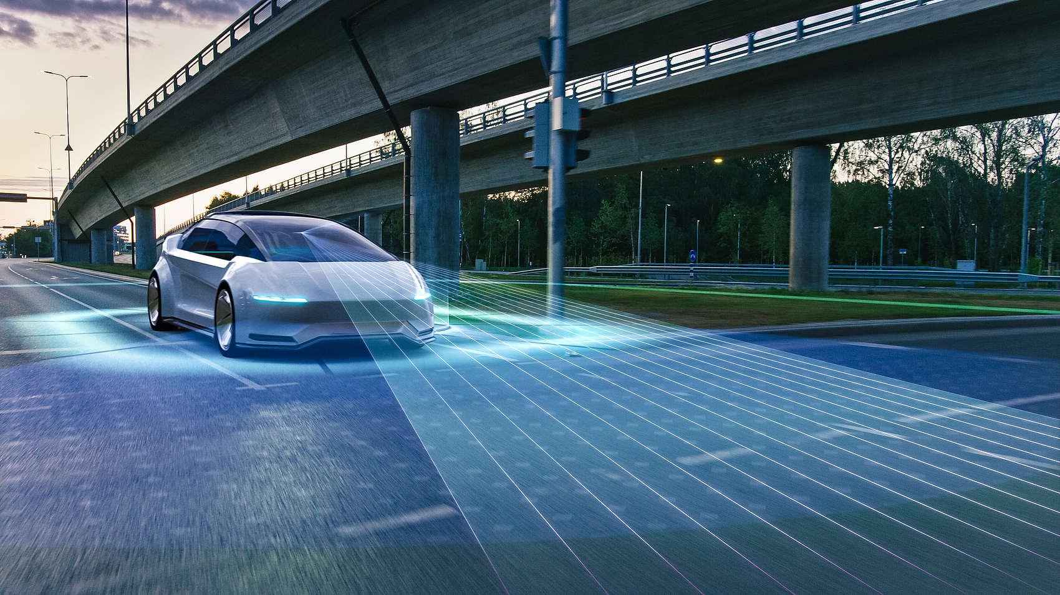
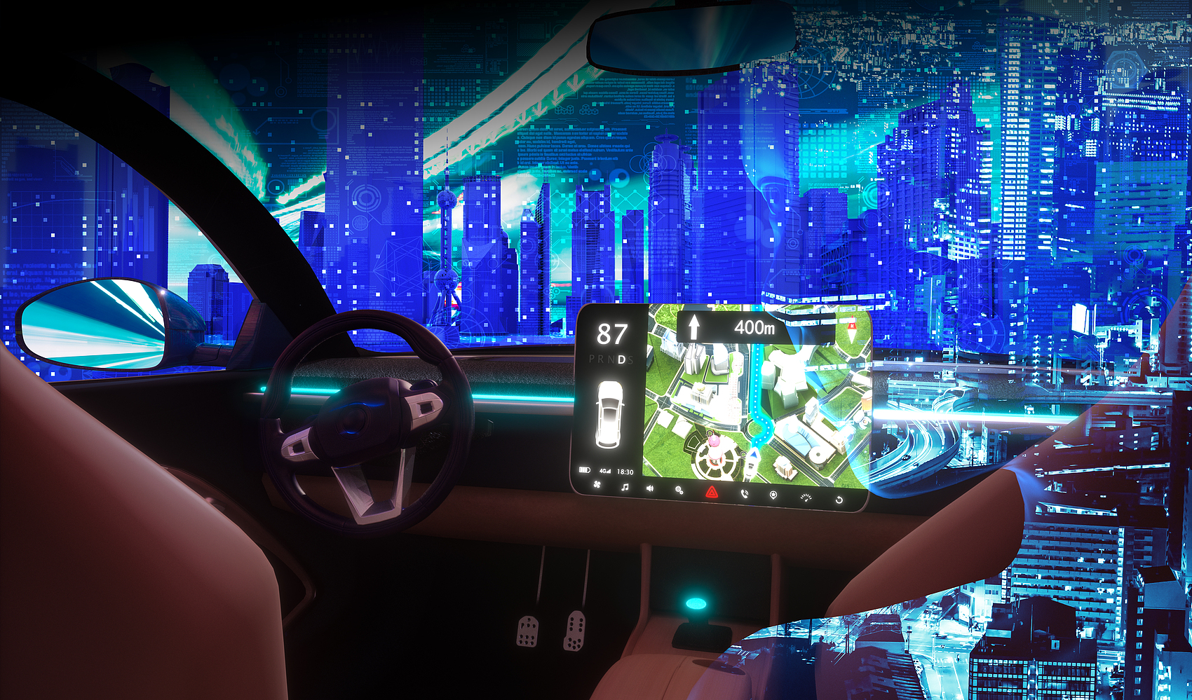
Real-time optimization engineering practice
TensorRT model quantization
Multi-task parallel pipeline
Memory optimization strategy
FP32→INT8 quantization reduced the inference speed from 86ms to 23ms while maintaining 98.7% model accuracy
CUDA stream parallel processing visual encoding (15ms) + planning decision (8ms), the overall frame rate increased from 30FPS to 65FPS
Using ring buffer management, memory usage was reduced from 8.2GB to 3.7GB and support for Jetson AGX Xavier deployment

Slide 21
Results verification and prospects
05

Slide 22



CARLA platform test verification
Multi-scenario verification system construction
Establish a test matrix containing 8 types of scenarios: intersection (30%), roundabout (20%), road section under construction (15%), night (12%), rain day (10%), pedestrian crossing (8%), vehicle jam (3%), emergency braking (2%), covering 98% of real road conditions
Key performance optimization indicators
The inference delay was reduced from 230ms to 85ms through model quantization, the trajectory tracking error was reduced by 42%, and the task completion rate was achieved to 92.3% in Town05 scenario (baseline model 78.5%)
Safety redundancy mechanism design
Using the dual-world model parallel reasoning architecture, the backup model takes over within 0.5 seconds when the main model fails, and the MTBF (mean time between failures) of the system reaches 1500 hours

Slide 23

Technology evolution trend insight
Multimodal fusion architecture breakthrough
Improved causal reasoning ability
DriveGPT4 solution achieves visual-language-control trinity alignment, improves command understanding accuracy to 89%, and reduces decision time at complex intersections by 40% (Tesla FSD v12 measured data)
The GAIA-2 model introduced a causal graph network, and in CARLAs "ghost probe" scenario, the collision rate was reduced from 12% to 3.8%, and the inference delay was controlled within 120ms

Slide 24

Technology evolution trend insight
Physical engines are deeply coupled
Simulation training closed-loop innovation
The NVIDIA Omniverse and CARLA integration achieves millimeter-level physical simulation accuracy, with vehicle dynamics model errors less than 0.05°, and supports real-time interaction of more than 1000 agents
The latest version of Waymo reduces the reconstruction error of NeRF to 2.3cm, builds a virtual scene library of more than 100,000 high-precision models, and reduces the model iteration cycle from 3 weeks to 72 hours

Slide 25
thanks
THE END

